Slide 1

Comprehensive Test Pass Report
Anil Erturk, Derek Bugg, Eugenio Lorenzo, Mu Li
Team 9 CS570 Software Testing
School of Technology & Computing (STC)

Slide 2
Agenda
Introduction/Purpose
TriTyp Class
Cal Class
IntegerSet Class
Thermostat Class
Testing Methods
Testing Reports
Bugs
Conclusion

Slide 3
TriTyp Class
Code Purpose:
Using 3 integers representing triangle side length, categorize triangle as scalene, isosceles, equilateral or invalid

Slide 4
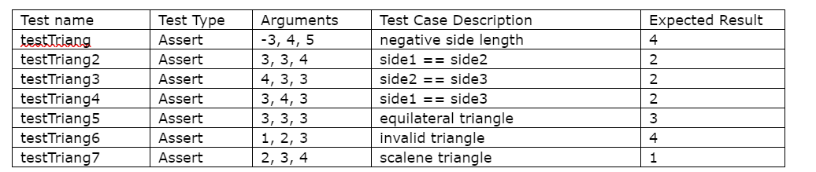
TriTyp Class
Test Cases

Slide 5
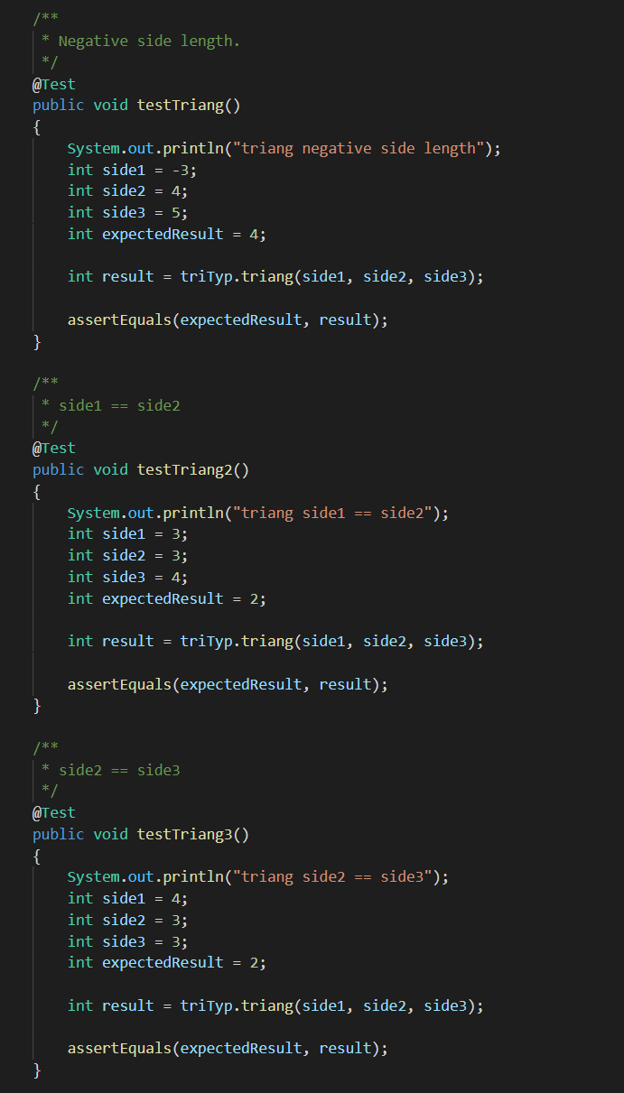
TriTyp Class

Slide 6
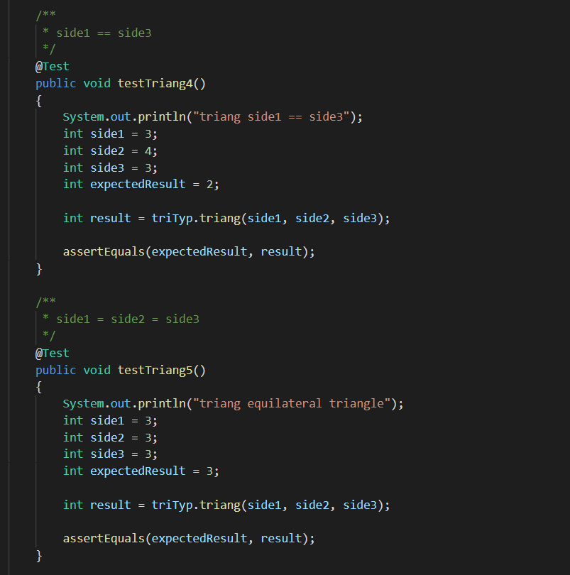
TriTyp Class

Slide 7
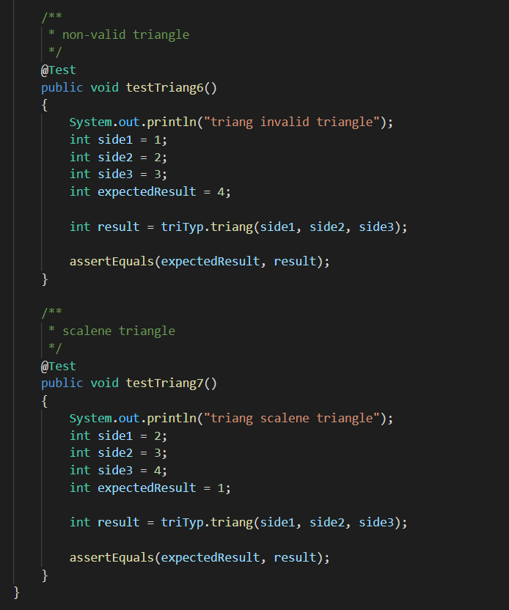
TriTyp Class

Slide 8
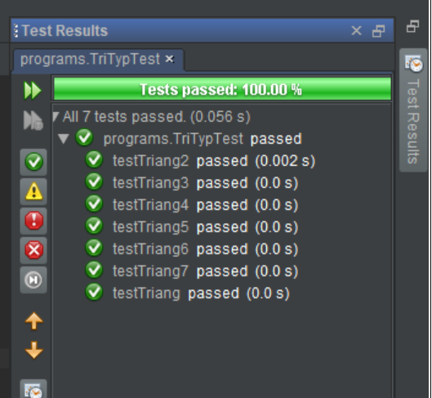
TriTyp Class
All tests for TriTyp passed...

Slide 9
Cal Class
Code Purpose:
Calculates the number of days between two dates of the same year, accounting for leap years

Slide 10
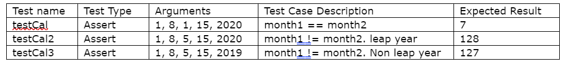
Cal Class
Cal Class Test Cases

Slide 11
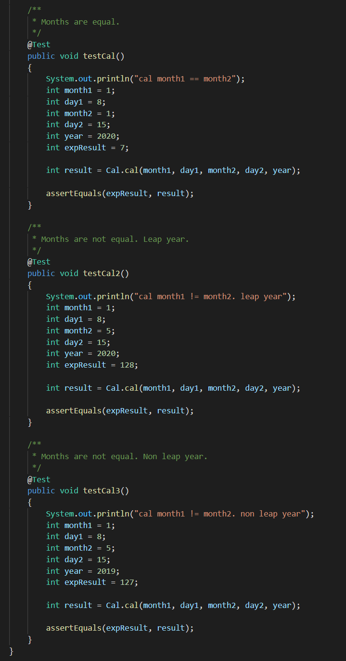
Cal Class

Slide 12
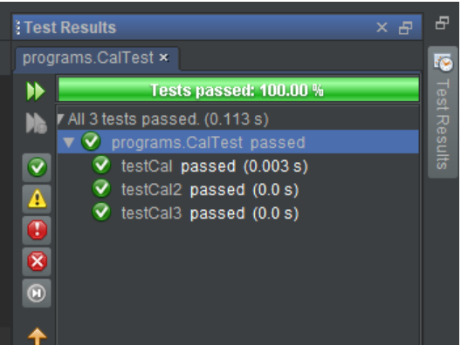
Cal Class
All tests for Cal passed...

Slide 13
Thermostat Class
Code Purpose
TurnHeaterOn method of class Thermostat determines whether to turn on the thermostat or not based on the variables it has and based on variables of its ProgrammedSettings parameter called pSet.

Slide 14
Thermostat Class
Test Scope
There are multiple paths for execution. Test cases have been developed to cover all unique paths. JUnit tests have been written for all test cases.
Tests for the turnHeaterOn method are shown in Table 4.

Slide 15
Thermostat Class
Test name | Test Type | Arguments | Test Case Description | Expected Result
testTurnHeaterOn | Assert | thermostat, pSet | Heater should turn on. | true
testTurnHeaterOn2 | Assert | thermostat, pSet | Heater should not turn on. Override = true. | true
testTurnHeaterOn3 | Assert | thermostat, pSet | Heater should not turn on. | false
testTurnHeaterOn4 | Assert | thermostat, pSet | Heater should not turn on. | false

Slide 16
Thermostat Class
Tests
The turnHeaterOn method decides whether to turn on the heater based on many variables in the Thermostat class and ProgrammetSettings type pSet parameter. The following tests, test the different execution paths of this method.

Slide 17
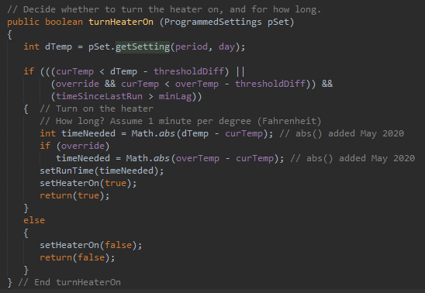
Thermostat Class

Slide 18
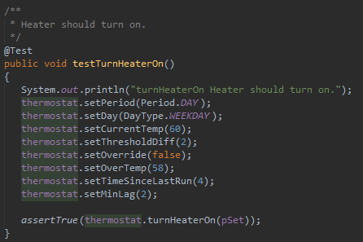
Thermostat Class
Using these parameters, the heater should turn on.

Slide 19
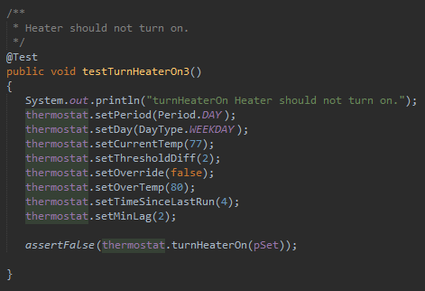
Thermostat Class
Using these parameters, the heater should not turn on.

Slide 20
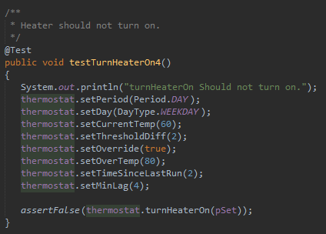
Thermostat Class
Using these parameters, the heater should not turn on.

Slide 21
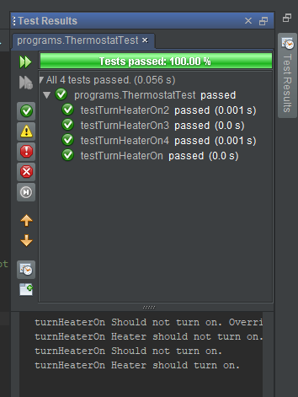
Thermostat Class
Bugs
The method acted expectedly for all test cases.

Slide 22
IntegerSet class
Code Purpose
The IntegerSet class has methods that allow it to si
Test Scope
There are multiple paths for execution. Test cases have been developed to cover all unique paths. JUnit tests have been written for all test cases.
Tests for the cal method are shown in Table 5.

Slide 23
IntegerSet Class
Test name | Test Type | Arguments | Test Case Description | Expected Result
testCal | Assert | 1, 8, 1, 15, 2020 | month1 == month2 | 7
testCal2 | Assert | 1, 8, 5, 15, 2020 | month1 != month2. leap year | 128
testCal3 | Assert | 1, 8, 5, 15, 2019 | month1 != month2. Non leap year | 127

Slide 24
References
9. REFERENCES
Ammann, P., & Offutt, J. (2017). Introduction to Software Testing (2nd ed.). Cambridge, UK: Cambridge University Press.
Axelrod, A. (2018). Complete Guide to Test Automation: Techniques, Practices, and Patterns for Building and Maintaining Effective Software Projects. Berkeley, CA: Apress.
Deitel, P. J., Deitel, H. M. (2015). Java: How to program: Early objects (10th ed.). Harlow, Essex: Pearson Education Limited.
Myers, G. J., Badgett, T., Thomas, T. M., &amp; Sandler, C. (2004). The Art of Software Testing (2nd ed.). Hoboken, NJ: John Wiley & Sons.

